Slide 1

Financial statement analysis; Goodwill and share valuation
Python Programming | Built in function and user define function
Course: Python Programming | Chapter: Built in function and user define function | Bachelor of Computer Science and Engineering
DISCOVER · LEARN · EMPOWER
Notes:
Welcome to today's lecture where we bridge Python programming with financial analysis. We will explore how to use built-in and user-defined functions to calculate goodwill and share values. This session is designed to help you implement data structures for efficient financial data processing.

Slide 2
Course Outcomes
SLIDE 2 / 14
Course Outcome
CO | BT LEVEL | DESCRIPTION
CO1 | BT1 | Understand the syntax, control structures, and basic constructs of Python programming language
CO2 | BT3 | Apply functions, modules, and exception handling for modular program development
CO3 | BT3 | Implement data structures including lists, tuples, dictionaries, and sets for efficient data processing
CO4 | BT4 | Analyze and manipulate files, strings, and perform data handling operations
CO5 | BT5 | Design and develop real-world applications integrating multiple Python concepts
Chandigarh University
2 / 14
Notes:
Our primary outcome for this lecture is CO3. You will learn to use Python dictionaries to store financial ratios and lists to manage share price histories. This ensures you can process complex financial data efficiently using the correct data structures.

Slide 3
Learning Objectives
SLIDE 3 / 14
Learning Outcomes
1
Define goodwill and share valuation within the context of financial statements.
2
Apply user-defined functions to calculate average profits for goodwill.
3
Implement built-in functions to compute weighted average profits accurately.
4
Analyze share valuation using net asset value and yield methods.
5
Construct Python dictionaries to store and retrieve financial statement data.
Chandigarh University
3 / 14
Notes:
By the end of this session, you will be able to define key financial terms and apply them in code. You will learn to write functions that automate the calculation of goodwill based on average profits. We will also cover how to use built-in functions for weighted averages and share valuation.

Slide 4
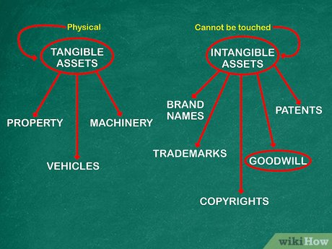
Lecture
SLIDE 4 / 14
Goodwill Definition and Concept
1
Goodwill represents the intangible value of a business reputation and customer base.
2
It is calculated as the excess of purchase price over net asset value.
3
User-defined functions allow custom logic for different goodwill calculation methods.
4
Financial statements provide the historical profit data required for these calculations.
5
Goodwill is an asset that appears on the balance sheet after acquisition.
6
Accurate valuation requires analyzing at least three to five years of profits.
7
Python lists can store the annual profit figures for easy iteration.
How to Account for Goodwill: A Step-by-Step Accounting Guide
Chandigarh University
4 / 14
Notes:
Goodwill is essentially the premium paid for a business's reputation. In Python, we treat this as a value derived from future profit potential. We will use lists to store past profits and calculate the average to determine this value.

Slide 5
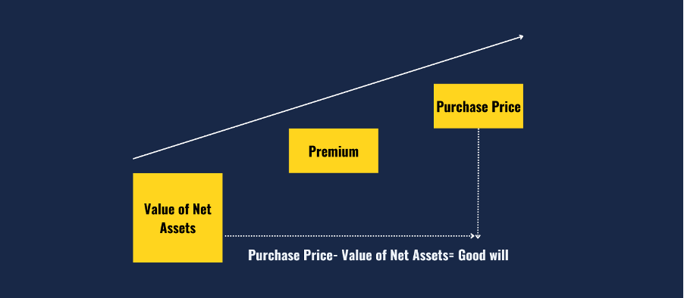
Lecture
SLIDE 5 / 14
Average Profit Method for Goodwill
GOVERNING EQUATION
The formula is: Goodwill = (Sum of Profits / Years) × Years Purchase
1
Average profit is the sum of past profits divided by the number of years.
2
Goodwill equals average profit multiplied by the number of years purchase.
3
User-defined functions encapsulate this logic for reusability in financial reports.
4
This method assumes future profits will remain consistent with past performance.
5
Negative profits in past years must be handled carefully in the code.
6
Python's built-in sum() function simplifies the calculation of total profits.
Source: mentormecareers.com
Chandigarh University
5 / 14
Notes:
The average profit method is the most common approach for goodwill valuation. We calculate the mean of past profits and multiply it by a purchase factor. For example, if average profit is 10,000 and purchase is 3, goodwill is 30,000.

Slide 6
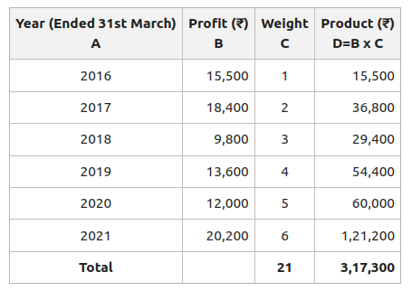
Lecture
SLIDE 6 / 14
Weighted Average Profit Method
1
Weighted average assigns higher importance to recent years of profit data.
2
Weights are typically 1, 2, 3, 4, 5 for the first five years respectively.
3
Goodwill equals weighted average profit multiplied by the years of purchase.
4
This method reflects the trend that recent performance is more predictive.
5
Python dictionaries can map years to their specific weight values easily.
6
The calculation involves summing (Profit × Weight) divided by sum of weights.
7
This approach provides a more realistic valuation for growing businesses.
Source: media.geeksforgeeks.org
Chandigarh University
6 / 14
Notes:
The weighted average method is superior for businesses with growth trends. We assign higher weights to recent years to reflect their importance. For instance, the most recent year might have a weight of 5, while the oldest has a weight of 1.

Slide 7
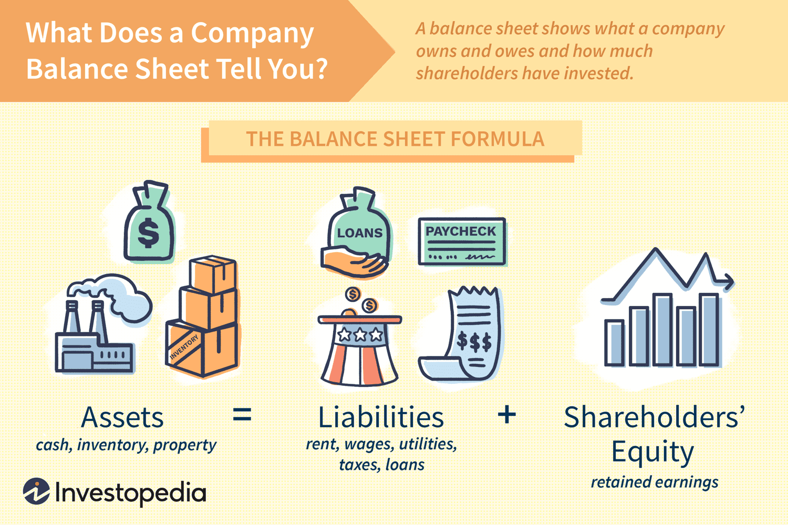
Share Valuation
SLIDE 7 / 14
Net Asset Method
GOVERNING EQUATION
The formula is: Value per Share = (Total Assets - Total Liabilities) / Shares
1
Net asset value is the total assets minus total liabilities of the firm.
2
Value per share equals net assets divided by the number of shares.
3
This method is ideal for valuing companies with significant tangible assets.
4
User-defined functions can calculate net assets from balance sheet data.
5
This approach provides a floor value for the share price.
6
Python sets can help identify unique asset categories for accurate counting.
Source: www.investopedia.com
Chandigarh University
7 / 14
Notes:
The net asset method calculates the liquidation value of the company. It is the most conservative approach to share valuation. If a company has 1 million in assets and 400,000 in liabilities, the net assets are 600,000.

Slide 8
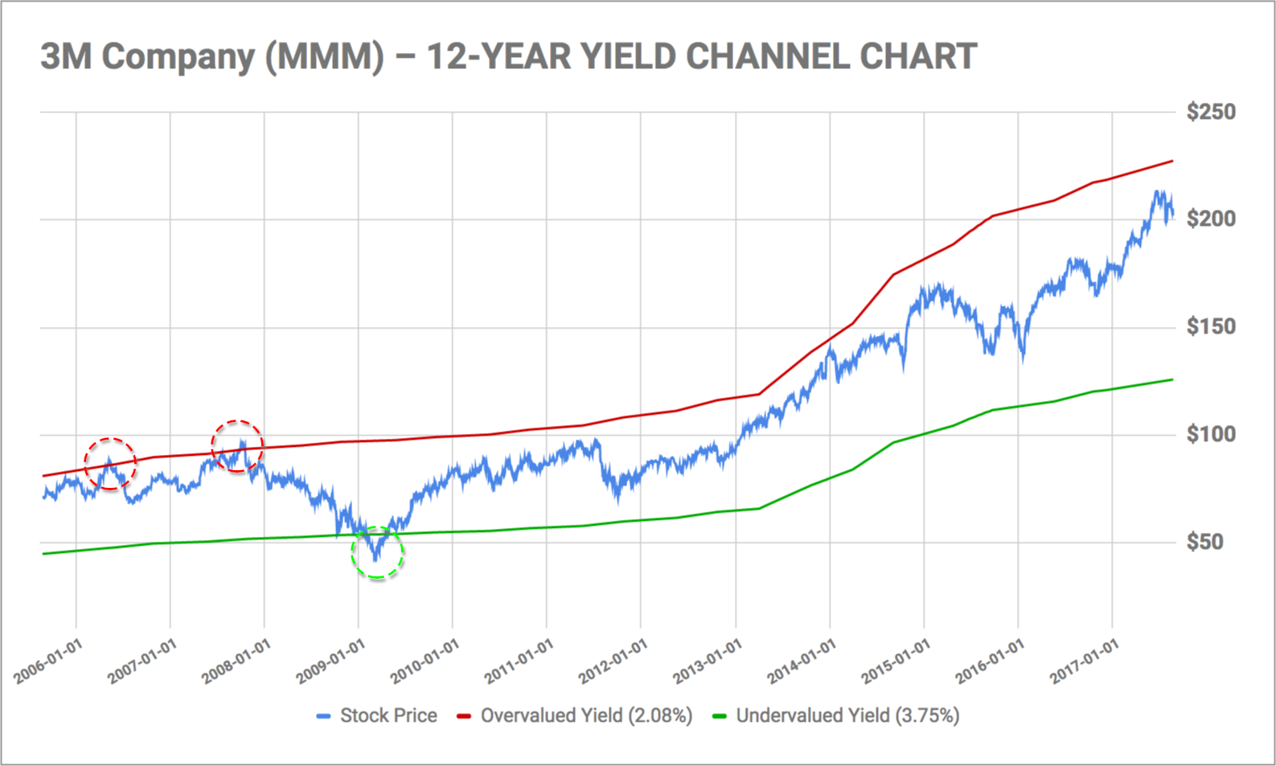
Share Valuation
SLIDE 8 / 14
Yield Method
GOVERNING EQUATION
The formula is: Value per Share = (Dividend per Share / Normal Rate) × 100
1
Yield method values shares based on expected future dividend returns.
2
Value per share equals normal dividend per share divided by normal rate.
3
This method is suitable for companies with stable and predictable dividends.
4
User-defined functions can automate the division and rate comparison logic.
5
It assumes the market rate of return is the benchmark for valuation.
6
This method often yields a higher value than the net asset method.
Source: static.seekingalpha.com
Chandigarh University
8 / 14
Notes:
The yield method focuses on income generation rather than asset liquidation. It values a share based on the return it provides to the investor. If a share pays a 10 rupee dividend and the normal rate is 10%, the value is 100 rupees.

Slide 9
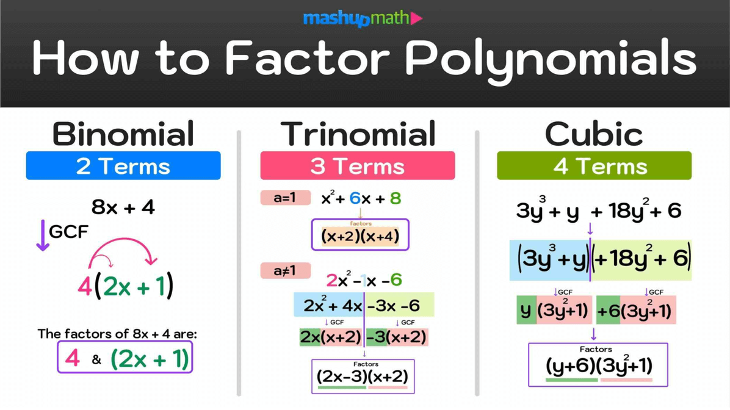
Worked Example
SLIDE 9 / 14
Goodwill Calculation
GOVERNING EQUATION
Average profit = (10+12+15+18+20) / 5 = 15,000
SCENARIO
Profits for 5 years are 10k, 12k, 15k, 18k, 20k.
WEIGHTED PROFITS
10(1)+12(2)+15(3)+18(4)+20(5) = 227.
• Goodwill at 3 years purchase = 15,000 × 3 = 45,000.
• Sum of weights = 1+2+3+4+5 = 15.
• Weighted average = 227 / 15 = 15.13.
• Goodwill at 3 years purchase = 15.13 × 3 = 45,390.
Source: images.squarespace-cdn.com
Chandigarh University
9 / 14
Notes:
Let's calculate goodwill for a company with profits of 10k, 12k, 15k, 18k, and 20k. The average profit is 15,000, leading to a goodwill of 45,000. Using the weighted method, the average is slightly higher at 15,133, resulting in a goodwill of 45,390.

Slide 10
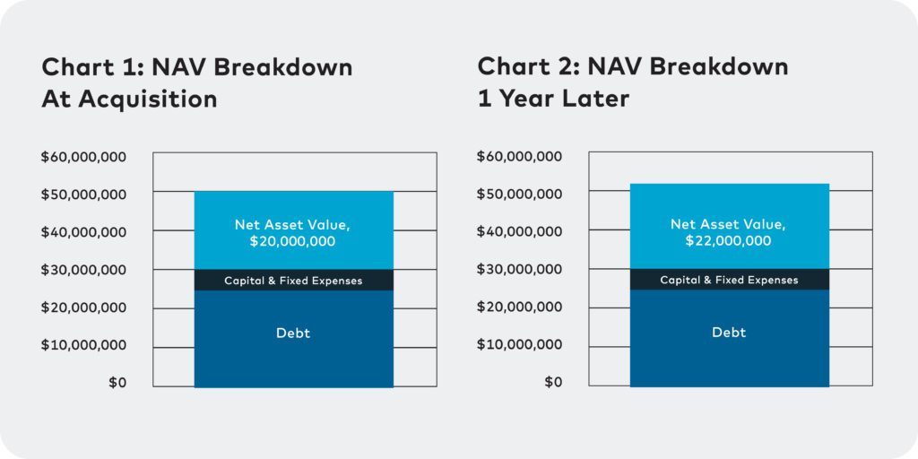
Worked Example
SLIDE 10 / 14
Share Valuation
GOVERNING EQUATION
Net Assets = 500,000 - 200,000 = 300,000
SCENARIO
Total Assets 500k, Liabilities 200k, Shares 10,000.
SCENARIO
Normal Dividend 5 per share, Normal Rate 10%.
• Net Asset Value per share = 300,000 / 10,000 = 30.
• Yield Value per share = (5 / 10) × 100 = 50.
• The yield method values the share higher than the net asset method.
• This discrepancy often indicates the presence of goodwill in the business.
Source: sp-ao.shortpixel.ai
Chandigarh University
10 / 14
Notes:
Consider a company with 500k assets and 200k liabilities. The net asset value per share is 30. If the normal dividend is 5 and the rate is 10%, the yield value is 50. This difference suggests the company has significant intangible value.

Slide 11
Lecture
SLIDE 11 / 14
Common Pitfalls in Valuation
1
Ignoring negative profits can skew the average profit calculation significantly.
2
Using outdated financial data leads to inaccurate goodwill estimates.
3
Failing to adjust for abnormal profits results in inflated valuations.
4
Incorrect weight assignment in weighted average methods distorts results.
5
Dividing by zero errors occur if the number of shares is zero.
6
Rounding errors in intermediate steps can affect the final share price.
7
Python code must include error handling for these specific edge cases.
Chandigarh University
11 / 14
Notes:
Students often make mistakes by ignoring negative profits or using outdated data. You must ensure your code handles zero shares to avoid division errors. Always validate your input data before running valuation functions.

Slide 12
Lecture
SLIDE 12 / 14
Python Implementation Strategy
1
Use lists to store annual profit data for easy iteration and summing.
2
Use dictionaries to map years to weights for the weighted average method.
3
Define a function calculate_goodwill(profits, years_purchase) for reuse.
4
Define a function calculate_share_value(net_assets, shares) for valuation.
5
Use built-in functions like sum(), len(), and max() for efficiency.
6
Encapsulate financial logic in user-defined functions for clarity and testing.
7
Print formatted output to display the final valuation results clearly.
Chandigarh University
12 / 14
Notes:
We will implement these calculations using Python lists and dictionaries. We define specific functions for goodwill and share valuation to keep the code modular. Using built-in functions like sum() makes the code cleaner and more efficient.

Slide 13
Lecture
SLIDE 13 / 14
Key Takeaways
1
Goodwill is calculated using average or weighted average profit methods.
2
Share valuation can be done via net asset or yield methods.
3
User-defined functions are essential for modular and reusable financial code.
4
Python data structures like lists and dictionaries are ideal for this data.
5
Always validate input data to avoid calculation errors and edge cases.
6
Accurate valuation requires careful selection of the appropriate method.
Chandigarh University
13 / 14
Notes:
To summarize, you now understand how to calculate goodwill and share values using Python. Remember that user-defined functions and data structures are key to implementing these financial models effectively. Always validate your data to ensure accurate results.

Slide 14
Lecture
SLIDE 14 / 14
References
PYTHON
A Practical Learning Approach, 1st Edition — T.S. Murugesh, Shriram K. Vasudevan, Sini Raj Pulari
• Learning Python, 6th Edition — Mark Lutz
• Starting Out with Python, Global Edition, 6th Edition — Tony Gaddis
• Introduction to Python Programming and Data Structures, 3rd Edition — Y. Daniel Liang
Chandigarh University
14 / 14
Notes:
These textbooks provide comprehensive coverage of Python programming and data structures. They will support your learning as you implement these financial analysis functions. Please refer to them for deeper insights into Python syntax and best practices.

